Slide 1
Democracy as propaganda for Capitalism
Justin Murphy, PhD
University of Southampton
jmrphy.net
@jmrphy

Slide 2
Most People think Propaganda is a tendency of authoritarian governments.

Slide 3


Slide 4
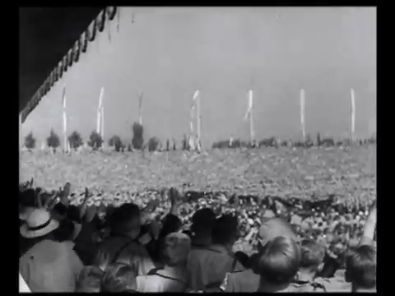

Slide 5


Slide 6
On the other hand, Most People Think
Free and open exchange of ideas is the tendency
Of Liberal / Capitalist/ Democratic governments.

Slide 7
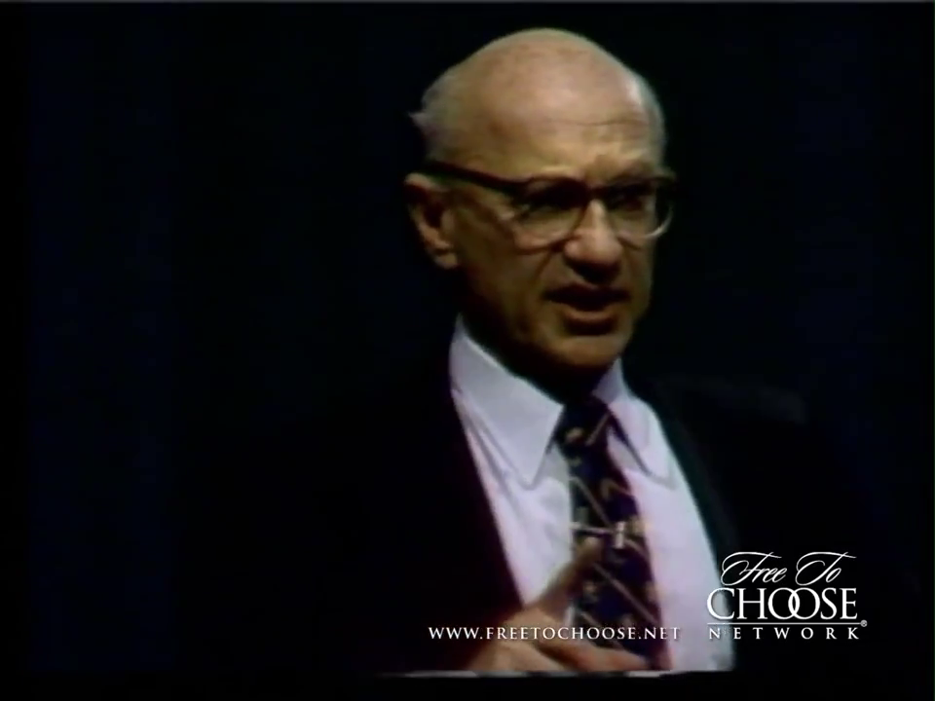

Slide 8
This is wrong.
Modern mass propaganda was invented under liberal capitalism.
Indeed, the notion of “Democracy” is perhaps the most successful piece of propaganda ever deployed; to the benefit of corporate and state elites seeking to silence the actual movement of real democracy.

Slide 9
1. Modern MASS Propaganda was invented under Liberal Capitalism
The first nation-wide, systematic manipulation of public opinion was by the United States government in WW1.
The U.S. public was strongly opposed to entering WWI.
After election (1916), the Wilson administration decides to enter.
Wilson administration conducts a systematic propaganda campaign.
Committee on Public Information, aka the Creel Commission.

Slide 10
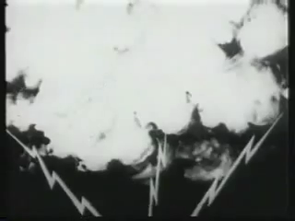

Slide 11
1. Modern MASS Propaganda was invented under Liberal Capitalism
The first nation-wide, systematic manipulation of public opinion was by the United States government in WW1.
The U.S. public was strongly opposed to entering WWI.
After election (1916), the Wilson administration decides to enter.
Wilson administration conducts a systematic propaganda campaign.
Committee on Public Information, aka the Creel Commission.
This launches the propaganda of “Democracy” as a good thing states would now claim to be.
Hitherto, “democracy” had always meant “chaos” & states were there to prevent it. It had always been a pejorative, much like how many people say “anarchy” today.

Slide 12
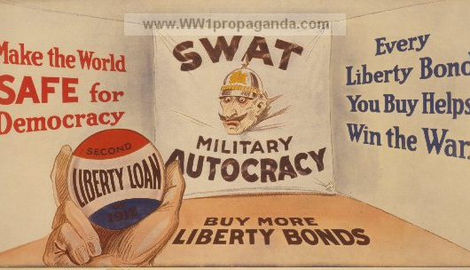

Slide 13
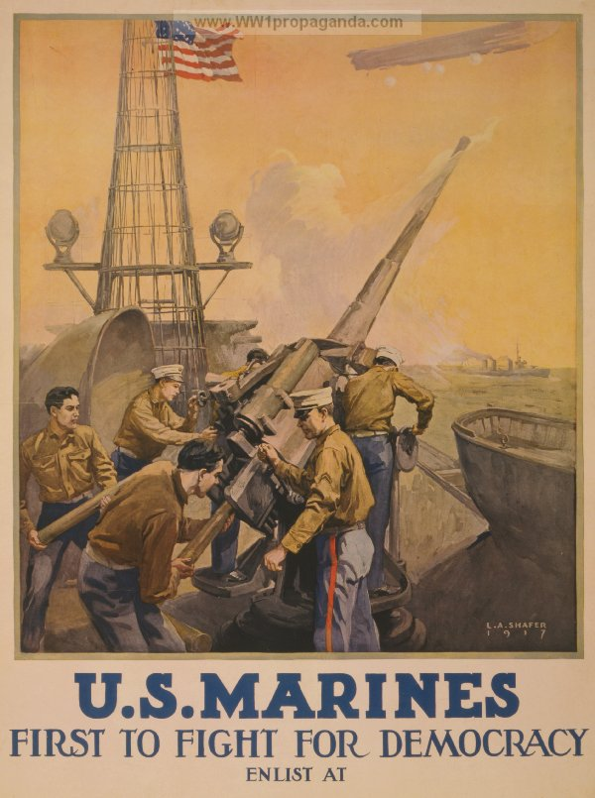

Slide 14
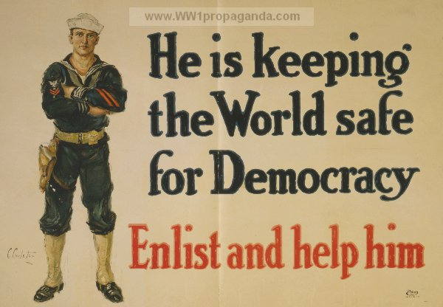

Slide 15
Let’s look Deeper Into the Fossil Record.

Slide 16
Percentage of books containing each word per year, based on a sample of about 4% of all books, via Google’s “Ngram” database.

Slide 17
1. Modern MASS Propaganda was invented under Liberal Capitalism
The first nation-wide, systematic manipulation of public opinion was by the United States government in WW1.
The U.S. public was strongly opposed to entering WWI.
After election (1916), the Wilson administration decides to enter.
Wilson administration conducts a systematic propaganda campaign.
Committee on Public Information, aka the Creel Commission.
This launches the propaganda of “Democracy” as a good thing states would now claim to be.
Hitherto, “democracy” had always meant “chaos” & states were there to prevent it. It had always been a pejorative, much like how many people say “anarchy” today.
Also launches the propaganda equation “nation = business”
Therefore “unions = bad for the nation.”
Workers were largely opposed to the “rich man’s war.”

Slide 18
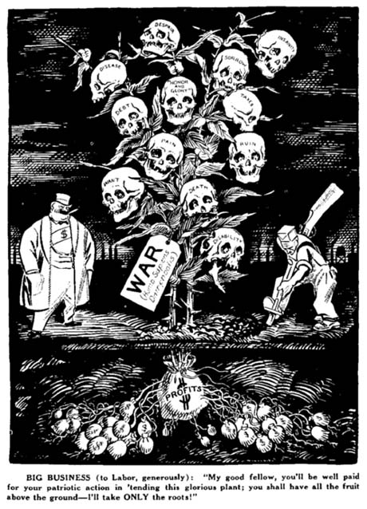

Slide 19


Slide 20
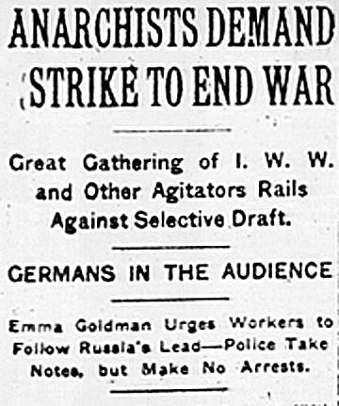

Slide 21
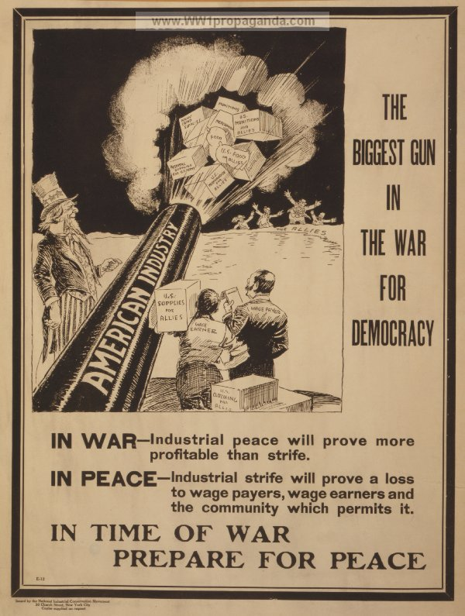

Slide 22
